Slide 1



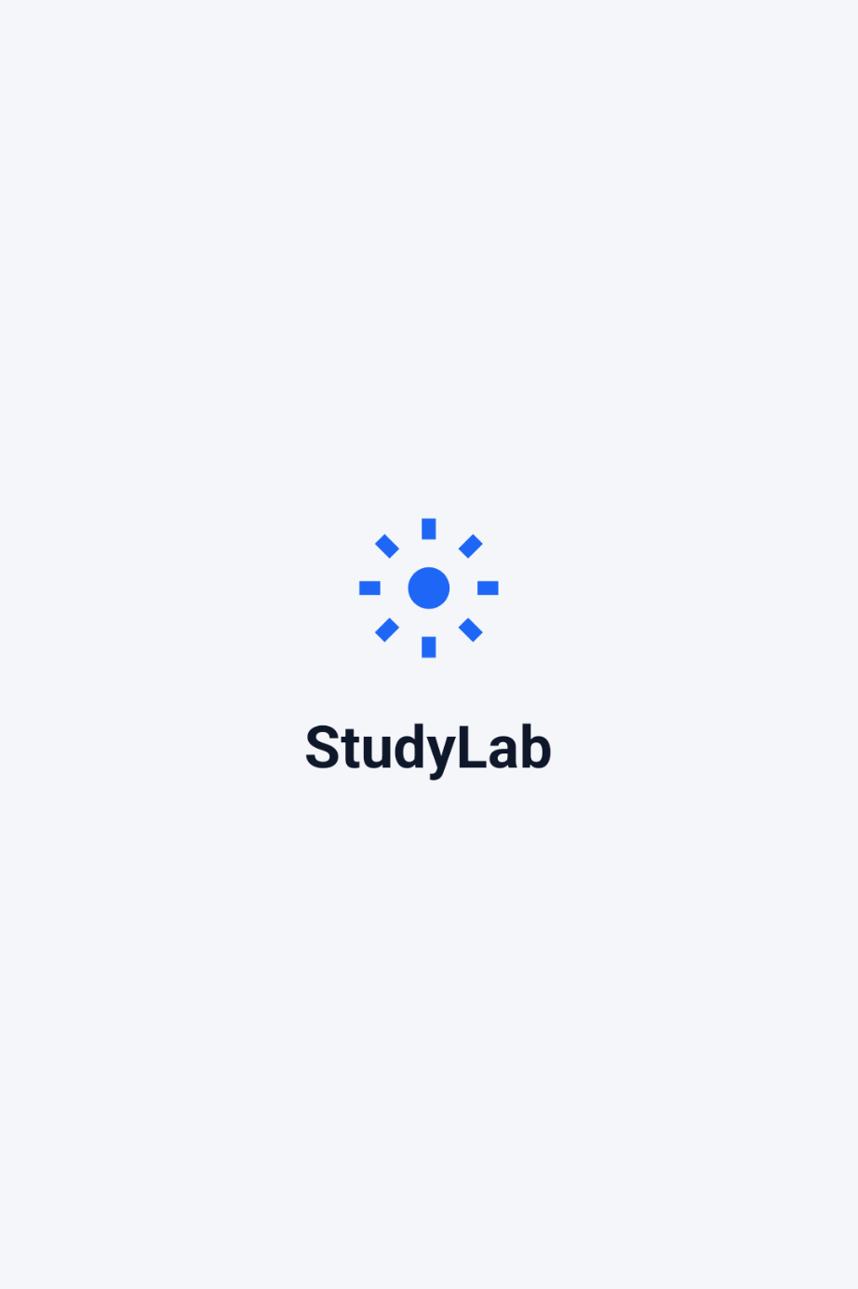
StudyLab
Advanced Academic Analytics
"Bridging the gap between student self-study and mentor oversight."
Core Team
Aakriti Rana (240354) & Arnav Gupta (240399)
Abhijeet Gupta (240360) & Aaryaman Pratap Singh (240356)
Technology Stack
Android
Next.js
FastAPI
MySQL
Redis

Slide 2


WHAT PROBLEM ARE WE SOLVING?
The Fragmentation
The StudyLab Solution
Modern learning is highly fragmented. Students use disparate apps for timers, notes, and tasks, making it impossible for educators to track actual study habits in real-time.
A unified ecosystem where students track academics via Android, while mentors gain real-time, data-driven insights through a web-based Analytical CRM.
Relational Advantage: Our robust model maps complex relationships (Students ↔ Subjects ↔ Sessions ↔ Mentors) to enable deep temporal aggregation.

Slide 3

USER ROLES & PERSONAS
smartphone
Student (Data Generator)
Uses the Android app to log study sessions, track daily habits, manage academic vaults, and complete assigned tasks.
analytics
Mentor (The Analyst)
Uses the Next.js CRM to monitor assigned mentees, review activity feeds, and analyze cohort performance using metrics.

Slide 4






HIGH-LEVEL SYSTEM ARCHITECTURE
Frontend
Backend
Database
Mobile: Native Android (Java/Kotlin) for student study workflows. Web: Next.js dashboard for mentor-side deep analytics.
FastAPI: High-performance Python REST APIs. Redis: In-memory caching to accelerate heavy analytical queries.
MySQL: Cloud-hosted relational persistence. Integrity: Enforced through strict relational constraints and ACID compliance.

Slide 5

DATABASE ENTITY MANAGEMENT
Domain | Core Entities (Tables) | Functional Role
Identity | accounts | Authentication and role-based access control.
Mentorship | mentor_assignments | Linking mentees to specific guides/analysts.
Academic | subjects, vault_files | Organizing materials, subjects, and study links.
Activity | study_sessions, check_ins | Tracking time-series duration and timestamps.
Assessments | mentor_tasks, assessments | Goal tracking, status auditing, and task trail.

Slide 6
BEYOND CRUD: DATA SYNTHESIS
ACID Compliance: We leverage database transactions to ensure relational safety during student deletion (e.g., ON DELETE CASCADE for mentor mappings).
Performance at Scale: Implementation of Redis caching ensures sub-millisecond responses for heavy analytical read-only data for mentors.
SQL-Side Derivation: Heavy calculation logic (like total study duration across months) is pushed to the SQL layer, adhering to enterprise DBMS best practices.

Slide 7
ADVANCED SQL: VIEWS & PERFORMANCE
SQL VIEW: vw_mentor_roster
Query Performance: Index Impact
Abstracted a massive JOIN across 4+ tables into a single SQL VIEW, enabling API routes to issue one clean SELECT.
dailyentries: user_id + date filter | Full Scan ➔ Range Seek
subjects: firebase_uid + sort | Filesort ➔ Index Sort
vault_files: MATCH() AGAINST() | LIKE scan ➔ FULLTEXT
notifications: account_id + is_read | Partial Composite
CREATE OR REPLACE VIEW vw_mentor_roster AS
SELECT ma.mentor_account_id, a.name AS student_name,
COUNT(DISTINCT s.id) AS subjects_count
FROM mentor_assignments ma ... GROUP BY ma.id;
Composite Index Types Used
⚡ Viva Point: Queries this View to render rosters instantly without re-computing 4-way JOINs on every load.
B-TREE: dailyentries
idx_subj_uid_archived: subjects INDEX(firebase_uid, is_archived, created_at DESC) — Most-selective column first.
ftx_vf_text: vault_files FULLTEXT(note_name, description, file_name) — Ranked relevance vs. LIKE '%x%'.
idx_de_user_date: dailyentries INDEX(user_id, entry_date) — Powers the 7-day streak and at-risk queries.
STUDYLAB · CSE2021 · GROUP 13

Slide 8
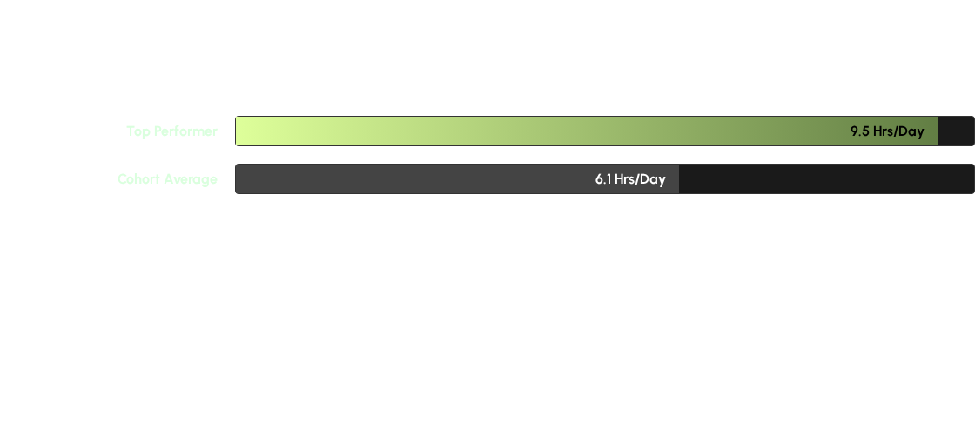
ANALYTICS: SUBQUERIES & FILTERING
Correlated Subqueries: Used to identify "Top Students" who outperform the average study time of their specific peer group under the same mentor.
Group By & Having: Instantly flagging "Overloaded Mentors" who are assigned >5 active mentees, ensuring balanced workload distribution.

Slide 9

AUTOMATION: PROCEDURES
System Encapsulation
Stored Procedures: ArchiveInactiveMentees encapsulates mass update logic inside the database. A single CALL clears users inactive for 30+ days.
Audit Triggers: SQL Triggers on the assessments table record state changes, ensuring an unbreakable trail that the app layer cannot bypass.

Slide 10


Conclusion
StudyLab transforms raw student actions into structured Actionable Intelligence. It is a robust relational data pipeline designed for institutional scaling.
Predictive AI
Horizontal Scaling
Integrating ML to flag at-risk students based on historical volatility in session data.
Sharding the database across campus nodes to support 10,000+ concurrent users.
THANK YOU | QUESTIONS?

